Slide 1

Protecting personal data
Wycliffe Bahati
Matriculation: 92014201
DLMCSITSDP01– Cyber Security and Data Protection
Notes:
NOTE:
To change the image on this slide, select the picture and delete it. Then click the Pictures icon in the placeholder to insert your own image.

Slide 2

Protecting personal data
Introduction
Different technical approaches to data protection
Anonymization
Pseudonymization
Encryption
Comparison of the different techniques in data protection
Advantages and Disadvantages
Summary
Bibliography

Slide 3
Introduction
It has become more important that ever to be able to ensure data privacy. It has become common for data have been lost to hackers. This has necessitated International standards such as GPDR that have laid out some of the requirements that data controllers and processors need to follow to ensure that after data is collected from PII is protected from unauthorized access. One way we ensure data privacy is by making sure that the data is not easily accessible or interpreted by unauthorized access. We will discuss different technical approaches that can be used in order to protect personal data. This will include Encryption, Anonymization and Pseudonymization.

Slide 4
Different technical approaches to data protection
Anonymization
This is the process of removing attributes from can easily identify PII. This can be either direct or indirect attributes that can lead to identifying the subject. Examples of direct identifies are Name, Phone number, Social security number. Indirect identifies include job held, postal code Once this identifies have been removed the data can be used and does not fall in the scope of some standards such as GPDR. After anonymization it might not be possible to reverse this to the original data. This is can either be done by
Suppression – This is where attributes are removed completely
Generalization – This can be achieved by replacing data that is very specific to a group or range that categorizes the data set
Example
Below is an example of a database of results of high school students. A processor is tasked to assess the performance of the schools and needs the grades for each school
Example

Slide 5
Different technical approaches to data protection
Pseudonymization
Article 4(5) of GPDR define Pseudonymization as “‘pseudonymization’ means the processing of personal data in such a manner that the personal data can no longer be attributed to a specific data subject without the use of additional information, provided that such additional information is kept separately and is subject to technical and organizational measures to ensure that the personal data are not attributed to an identified or identifiable natural person;
Basically, Pseudonymization is the process where attributes are changed such that the information cannot be attributed to PII. This can only happen with the use of additional information is not include in the data. This information is kept away from the data and is kept secret

Slide 6
Pseudonymization (Cont)
Pseudonymization Example
This can be achieved by
Tokenization – This is where we substitute elements with tokens. The token itself has no meaning but can map back to the original element. This can either be
On demand random Assignment based Tokenization – This is where for every element you create a mapping is created in a database. To reverse the token, you need to do lookup in the database
Stateless open scheme tokenization which can be
Static table-based tokenization scheme which is algorithm based
Encryption based – Using a key for example AES

Slide 7
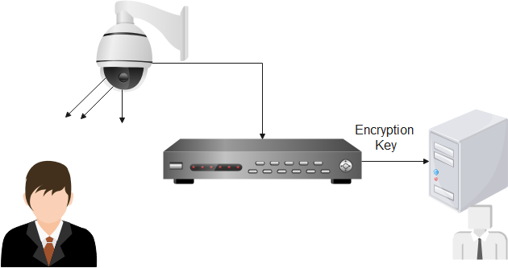
Encryption
This is the process to encode data (normally using a mathematical function) such that only users who are authorized can access it by having the decryption key. This can assist the PII controllers and processor to comply with regulations on data privacy by ensuring that the data is safe from cyber breach. Encryption is also key in ensuring data in motion or at rest is not easily accessible.
Common encryption algorithms include AES, DES, 3DES.
Example
Database storage for collected CCTV cameras can be stored in a database with and encryption Key. For one to access they would need the decryption key to access the data

Slide 8
Comparison of the different techniques in data protection
Data Protection Technique | Advantages | Disadvantages
Anonymization | Non reversable. Data cannot be mapped back to the PII object hence ensure privacy Protects data from possible loss to unauthorized access Even with failure of external protection parameter the data is still not useful to attackers | Renders data useless for some data science applications Data cannot be used by organizing for activities such as marketing
Pseudonymization | Data can be mapped back to the original element with a special key stored separately making it possible to apply data science applications use. | The data is only as safe ask the key. Once the key is compromised the data can be accessed
Encryption | Data is stored in encrypted form. A decryption key is needed to transform the data in the original form ensuring data privacy Asymmetric encryption makes it possible to transfer data safely and ensure consistency of the data | There are chances that with the key a hacker can de-encrypt the data and have access

Slide 9
Summary
Over time it has become very critical to shift from the original methods to protect data by building a perimeter around the data. Its now not possible to protect data by building perimeter as a result of
Need for data to be accessible via the internet.
Nee to share data with 3rd party from example outsourcing payroll or customer care
IOT devices that are recording and storing data in large volumes
Staff working from home and office that need access to the data.
This has led to data protection techniques becoming very critical when dealing with data. Organizations such as GPDF and the California consumer protection act are now giving guidelines on data protection. A lot of countries are now enacting laws that guard data privacy. In this presentation we have covered methods that we can use to protect data from unauthorized access. This techniques are critical in the future for organizations to avoid losing information and large fines from authorities for data leaks

Slide 10
Bibliography
European Union. (2018). Regulation (EU) 2016/679 of the European Parliament and of the Council of 27 April 2016 on the protection of natural persons with regard to the processing of personal data and on the free movement of such data, and repealing Directive 95/46/EC (General Data Protection Regulation). https://eur- lex.europa.eu/legal content/EN/TXT/?uri=CELEX%3A32016R0679
Elliot, M.; Mackey, E.; O’Hara, K. (2020): The Anonymisation Decision-Making Framework 2ndEdition. UKAN. https://ukanon.net/framework

